Slide 1
Application deployment on multiple edges
(Batch deploy)

Slide 2
Requirement Overview
Current Implementation of application deployment
Current implementation support application deployment on single edge host at a time.
Problem:
Can’t support application deployment on multiple edge hosts
Requirement:
Support application deployment on multiple edge hosts

Slide 3
Solution Architecture
MECM Portal
New module: Batch deployer.
New Process flow: Batch deploy PF
Batch deploy process flow call existing process flows in loop to perform application LCM.
APPO
API Handler
Batch Deployer
Inventory
DB
BPMN Execution Engine
APM
LCM Controller
Batch Deploy PF
New

Slide 4
Application deploy on multiple edges
MECM-FE
APPO
APM
APPO DB
Lcm
Controller
K8SInfra
Plugin
K8SInfra
Batch create app inst
Create App Instance
Request body includes list of edges
Returns app instance Id’s and corresponding edge info
Download application package
edge1, edge2, edge3...
[{appInstId1, edge1},{appInstId2, edge2}...]
Loop
Create app instance info with appInstIdx
Instance App instance
with [appinstId1, appInstId2, ...]
Accepted
Instantiate App Instance
Request body includes list of app Instance IDs
Returns app instance Id’s, edge info and request status=accepted/failed reason
Instantiate application in loop for all appinstance IDs
[{appInstId1, edge1, status=accepted/failed reason},{appInstId2, edge2, status=accepted/failed reason}...]
Loop
Instantiate app instance (app inst ID)
No rollback on failure
Instantiate (app inst ID)
Update status
Deploy

Slide 5
Application deploy on multiple edges
MECM-FE
APPO
APM
APPO DB
Lcm
Controller
K8SInfra
Plugin
K8SInfra
Query appInstInfo with [appinstId1, appInstId2, ...]
Query App Instance Info
Query parameter includes list of app Instance IDs
Returns app instance infos, Instantiate application in loop for all appinstance IDs
[{appInstInfo1}, {appInstInfo2}, {appInstInfo3}, ...]
Terminate App instance
with [appinstId1, appInstId2, ...]
Accepted
[{appInstId1, edge1, status=accepted/failed reason},{appInstId2, edge2, status=accepted/failed reason}...]
Terminate App Instance
Request body includes list of app Instance IDs
Returns app instance Id’s, edge info and request status=accepted/failed reason
Terminate applicationm instance in loop
Loop
Terminate app instance (app inst ID)
Terminate (app inst ID)
Undeploy
Update status

Slide 6
API changes
Create application identifier:
Instantiate application instance:
Request
Request
https://{{mecmIp}}:30201/appo/v1/tenants/{{tenant-id}}/app_instances/batch_create
https://{{mecmIp}}:30201/appo/v1/tenants/{{tenant-id}}/app_instances/batch_instantiate
{
"appPackageId":"ea339be5f1044dcf9f76b05db46f0a56",
"appName":"face_recognition",
"appInstanceDescription":"face_recognition",
"appId":"772312cb246c40d0bc726ad4ae57b1ef",
"mecHost": "[edgeHostIp1, edgeHostIp2, edgeHostIp...n ]"
}
{
“applicationInstances:” [ appInstanceId1,
appInstanceId2,
appInstanceId….n
]
}
Response:
200 Accepted
{
response: [
{
“appInstanceId”: ”uuid1”,
“edge”: “edgeHost1”,
“Status”: accepted
},
{“appInstanceId”: ”uuid2”,
“edge”: “edgeHost2”,
“status”: “failed reason”
}
]
}
Response:
200 Accepted
{
response: [
{
“appInstanceId”: ”uuid1”,
“edge”: “edgeHost1”
},
{
“appInstanceId”: ”uuid2”,
“edge”: “edgeHost2”
}
]
}

Slide 7
API changes
Query app instance info:
Terminate application instance:
Request
Request
https://{{mecmIp}}:30401/appo/v1/tenants/{{tenant-id}}/app_instance_infos?appInstId=uuid1&appInstId=uuid2
https://{{mecmIp}}:30201/appo/v1/tenants/{{tenant-id}}/app_instances/batch_terminate
{
...
}
{
“applicationInstances:” [ appInstanceId1,
appInstanceId2,
appInstanceId….n
]
}
Response:
200 Accepted
{
appInstanceInfos: [
{
“appInstanceId”: ”uuid1”,
“edge”: “edgeHost1”,
“operstatus”: “Instantiated”
},
{
“appInstanceId”: ”uuid2”,
“edge”: “edgeHost2”,
“operstatus”: “Instantiated Failed”
}
]
}
Response:
200 Accepted
{
response: [
{
“appInstanceId”: ”uuid1”,
“edge”: “edgeHost1”,
“Status”: accepted
},
{“appInstanceId”: ”uuid2”,
“edge”: “edgeHost2”,
“status”: “failed reason”
}
]
}

Slide 8
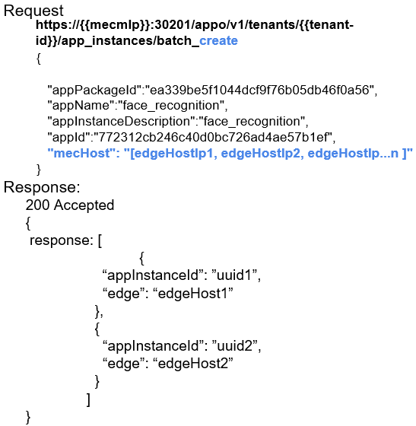
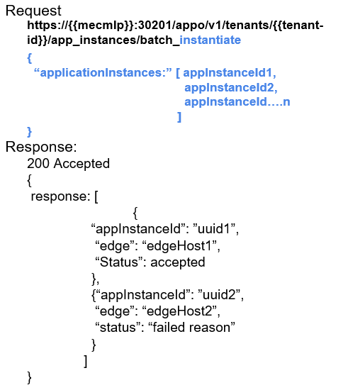
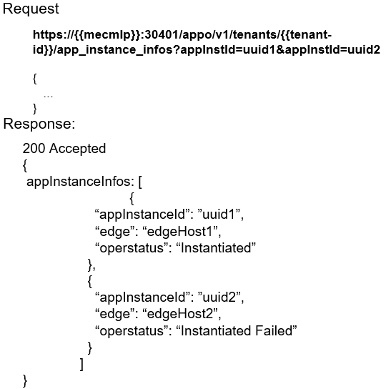
MECM-FE Design (TBD: YangYang)
MECM-FE
1
Create instance identifier
1
2
3
MECM-APPO
3
Instantiate application instance
2
Query app instance info
Should we put these parameters as one list in request parameters?

Slide 9
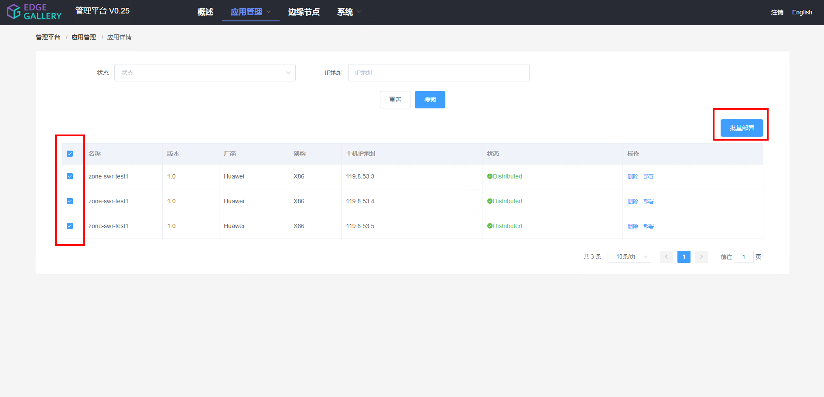
MECM-FE Design (TBD: YangYang)

Slide 10
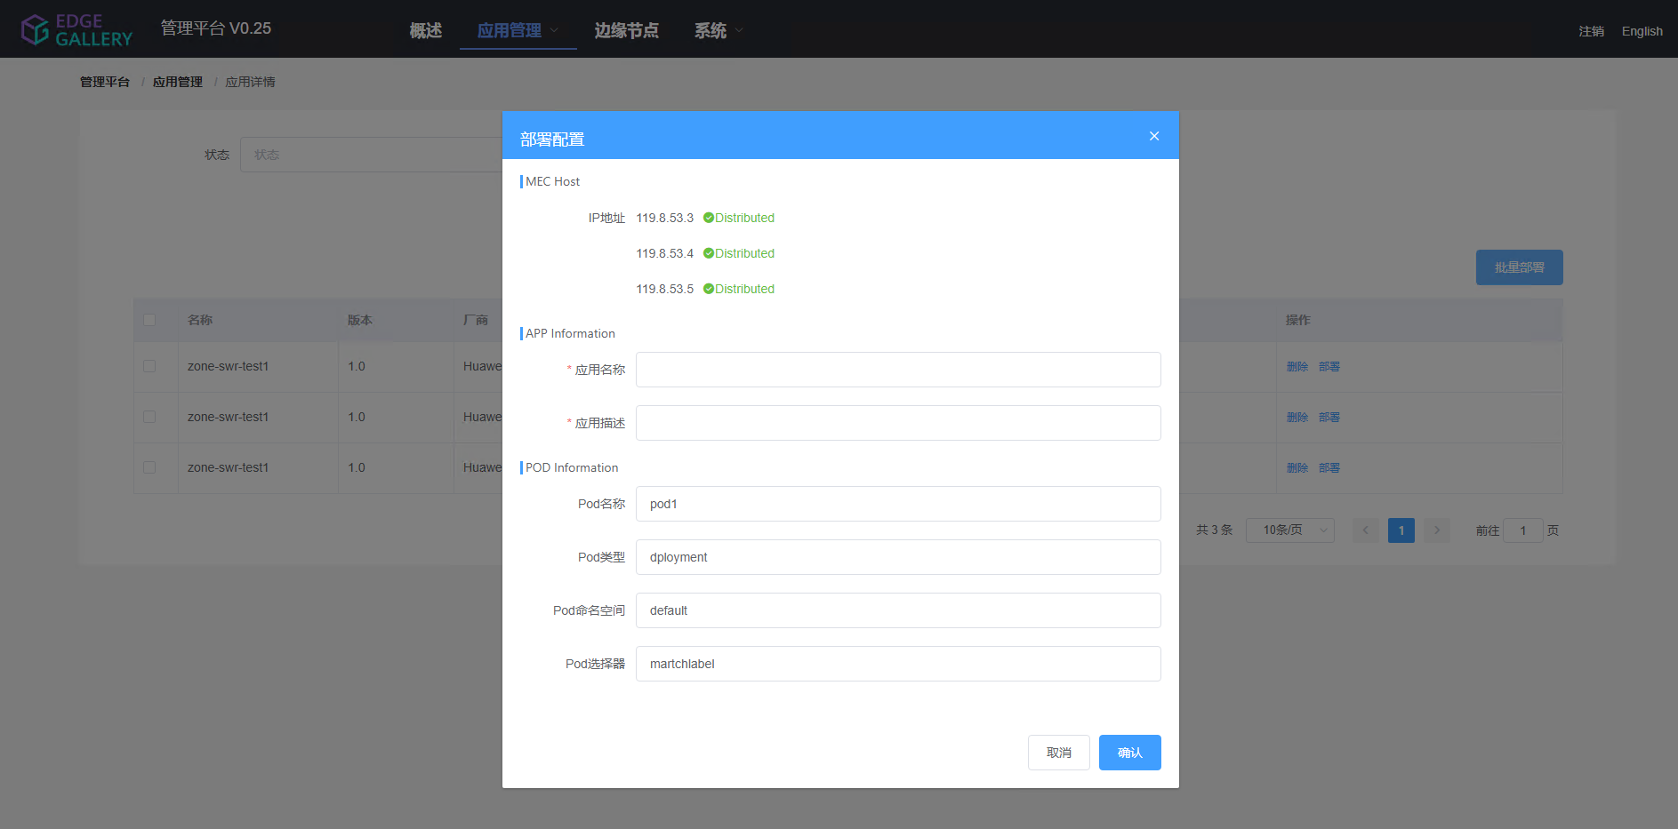
MECM-FE Design (TBD: YangYang)
Host ip display

Slide 11
Security Considerations
MECM Secure Design Considerations

Slide 12
Thank you

Slide 24
Solution 2

Slide 25
Batch Application deploy
MECM-FE
APPO
APM
APPO DB
Lcm
Controller
K8SInfra
Plugin
K8SInfra
Batch create app inst
edge1, edge2, edge3...
Batch ID
Loop
Create app instance info with batchId
Instance App instance
with batch ID
Accepted
[{appInstId1, edge1, status=accepted/failed reason},{appInstId2, edge2, status=accepted/failed reason}...]
Loop
Instantiate app instance (app inst ID)
Instantiate (app inst ID)
Deploy
Update status

Slide 26
Batch Application deploy
MECM-FE
APPO
APM
APPO DB
Lcm
Controller
K8SInfra
Plugin
K8SInfra
Query appInstInfo with batchID
[{appInstInfo1}, {appInstInfo2}, {appInstInfo3}, ...]
Terminate App instance
with batch ID
Accepted
[{appInstId1, edge1, status=accepted/failed reason},{appInstId2, edge2, status=accepted/failed reason}...]
Loop
Terminate app instance (app inst ID)
Terminate (app inst ID)
Undeploy
Update status

